Slide 1

Proposed Ad Campaign
For
The Hershey’s Company 8th April 2011

Slide 2
Today’s Presentation
What we know about your business
Product offerings
Presence in Singapore
Market analysis
Rationale for selected target audience
Competitors
Our proposed ad campaign
The “Big Idea”
Implementation

Slide 3

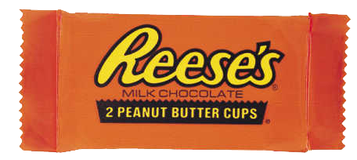
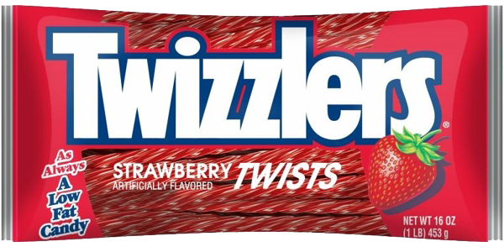
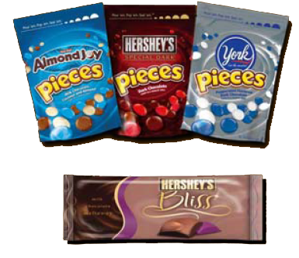
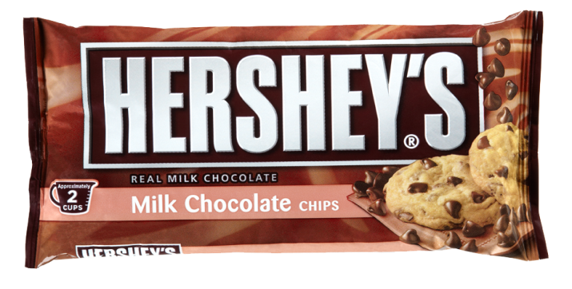
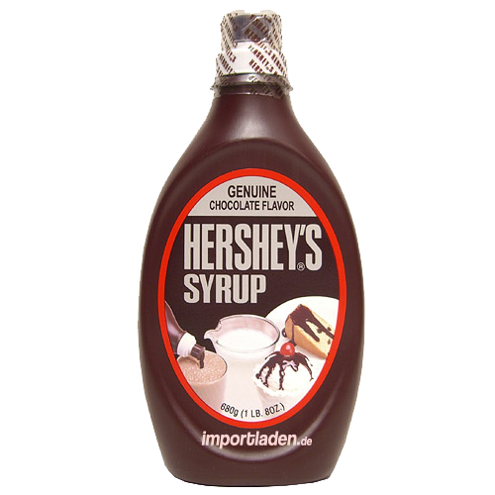
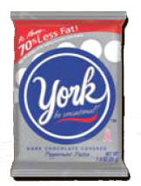
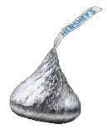
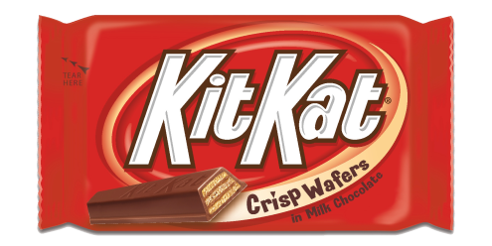
Hershey’s Business | Market Analysis | Ad Campaign
Product Offerings | Presence in Singapore
Notes:
Hersheys largest chocolate manufacturer in the USA.
Tasting of york chocolate.

Slide 4

Hershey’s Business | Market Analysis | Ad Campaign
Product Offerings | Presence in Singapore
Exclusive franchising rights for Hershey’s
Source: Channel News Asia 16 April 2010 2202 hrs
Notes:
Gill capital as Hershey’s representative in Singapore

Slide 5
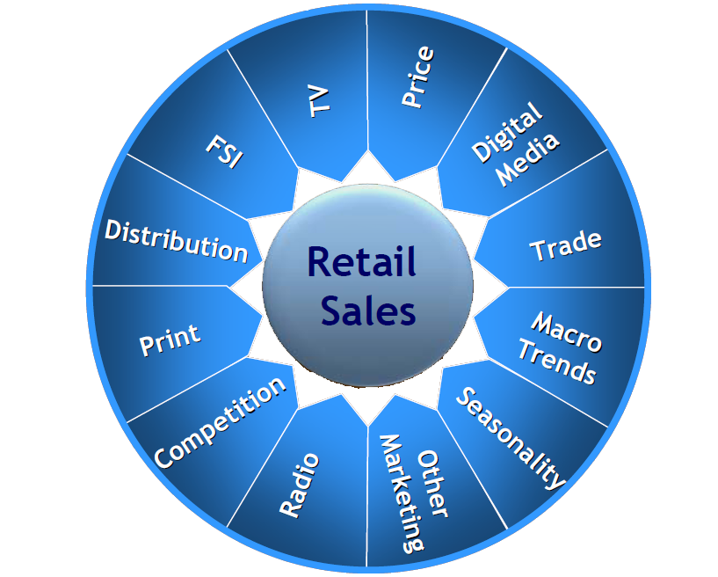
Hershey’s Business | Market Analysis | Ad Campaign
Advertising
(Ad Campaign)
Marketing (Market Analysis)
Variables affecting sales
Notes:
Over here we have identified several variables that would affect the sales of hershey’s product,
Of which the 2 main branches would be Advertising and Understanding the current market, picking up key trends.
Only through a firm understanding of the market would it enable us to develop an integrated marketing campaign efficiently.

Slide 6
Hershey’s Business | Market Analysis | Ad Campaign
Trends and Environment | SWOT | Positioning
Market Segmentation
Young Professionals
Teenagers
Families
Tourists
-> High purchasing power -> Demand for gifts -> Likely to visit CityLink
-> Singapore is a shopping mecca -> Tend to spend more than usual local customer base
-> Generally adequate purchasing power -> Savvy group -> Sensitive to price differences
-> Family members purchase products as gifts -> Promotional items such as gift baskets and bundling products with plush toys are attractive
Notes:
According to our research, these are the market trends that our group has identified.

Slide 7
Hershey’s Business | Market Analysis | Ad Campaign
Trends and Environment | SWOT | Positioning
Notes:
According to our research, these are the market trends that our group has identified.

Slide 8
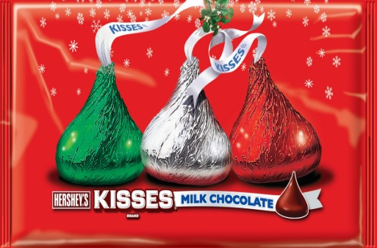

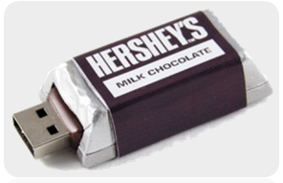
Hershey’s Business | Market Analysis | Ad Campaign
Trends and Environment | SWOT | Positioning
Festive and holiday seasons result in a rise in chocolate sales
Capitalize on this trend to base our advertising campaign on
Increase in tourism and growing affluence amongst locals
Larger market size
Technologically advanced environment of Singapore
Allows for easy integration of marketing effort
Notes:
According to our research, these are the market trends that our group has identified.

Slide 9
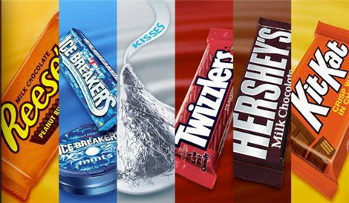
Hershey’s Business | Market Analysis | Ad Campaign
Trends and Environment | SWOT | Positioning
Strengths
Unique products
Signature package of Hershey’s products
Weakness
Relatively more expensive
Lack of existing advertising efforts

Slide 10


Hershey’s Business | Market Analysis | Ad Campaign
Trends and Environment | SWOT | Positioning
Opportunities
Capitalize on the success of Resorts World Singapore
Use of boutique store to position brand in Singapore
Innovative packaging ideas based on local cultures
Threat
Competitors offering similar products
Unpredictable economic conditions

Slide 11



Hershey’s Business | Market Analysis | Ad Campaign
Trends and Environment | SWOT | Positioning
Premium
Low Variety
High Variety
Budget
Notes:
Market positioning.

Slide 12
Hershey’s Business | Market Analysis | Ad Campaign
Consumer
Store Selection
Store Navigation
Product Selection
Overview
Our ad would influence consumer’s decision throughout the purchasing process.
Guiding them in their decision making process.
Notes:
Purchasing process.
We understand this process and base our campaign on it.

Slide 13

Hershey’s Business | Market Analysis | Ad Campaign
Understanding our target audience
Nothing beats Hershey’s Kisses…
I Love Hershey’s Chocolate Bar…
Notes:
Our target audience for ad campaign are going to be children aged 5 to 13 yrs of age.

Slide 14
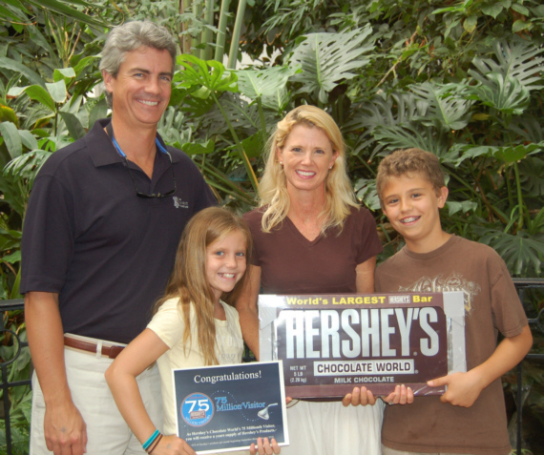
Hershey’s Business | Market Analysis | Ad Campaign
The Big Idea
“Fun in the Sun!”
Notes:
Our target audience for ad campaign are going to be children aged 5 to 13 yrs of age.

Slide 15
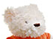
Hershey’s Business | Market Analysis | Ad Campaign
The Big Idea
Execution style - Hershey bear as our personality symbol.
Emotional appeal - happiness, cuddliness and sweetness, fun
Focus:
Kisses
Hershey’s Chocolate Bar
Notes:
Our target audience for ad campaign are going to be children aged 5 to 13 yrs of age.

Slide 16
Our Advertising Campaign
Phase 1
Phase 2
Qualitative Objective
Quantitative Objective

Slide 17
Phase I
To increase the liking of the brand among target audience by 10 percent within 2 months.
Qualitative Objective
Qualitative Objective
Craft emotionally appealing messages with the Hershey bear
Strategy
Outdoor Ad
TV Commercial
Main Tactics
Supporting Tactics
Magazines
Online Media
Cinema
Supporting Tactics

Slide 18
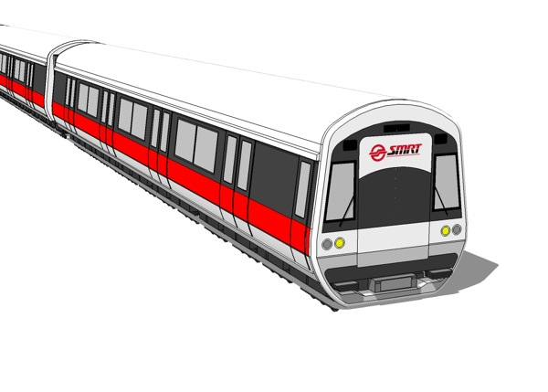
Outdoor Advertising
Transit Advertising

Slide 19
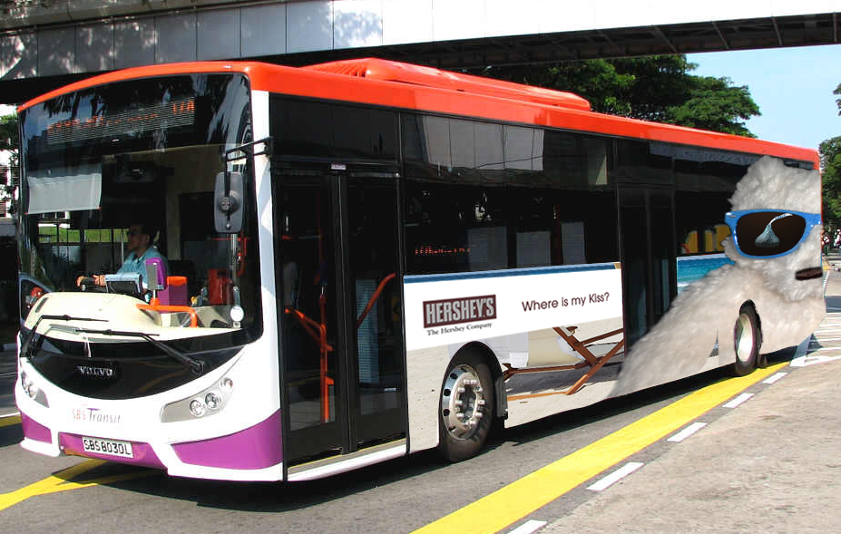
Outdoor Advertising

Slide 20
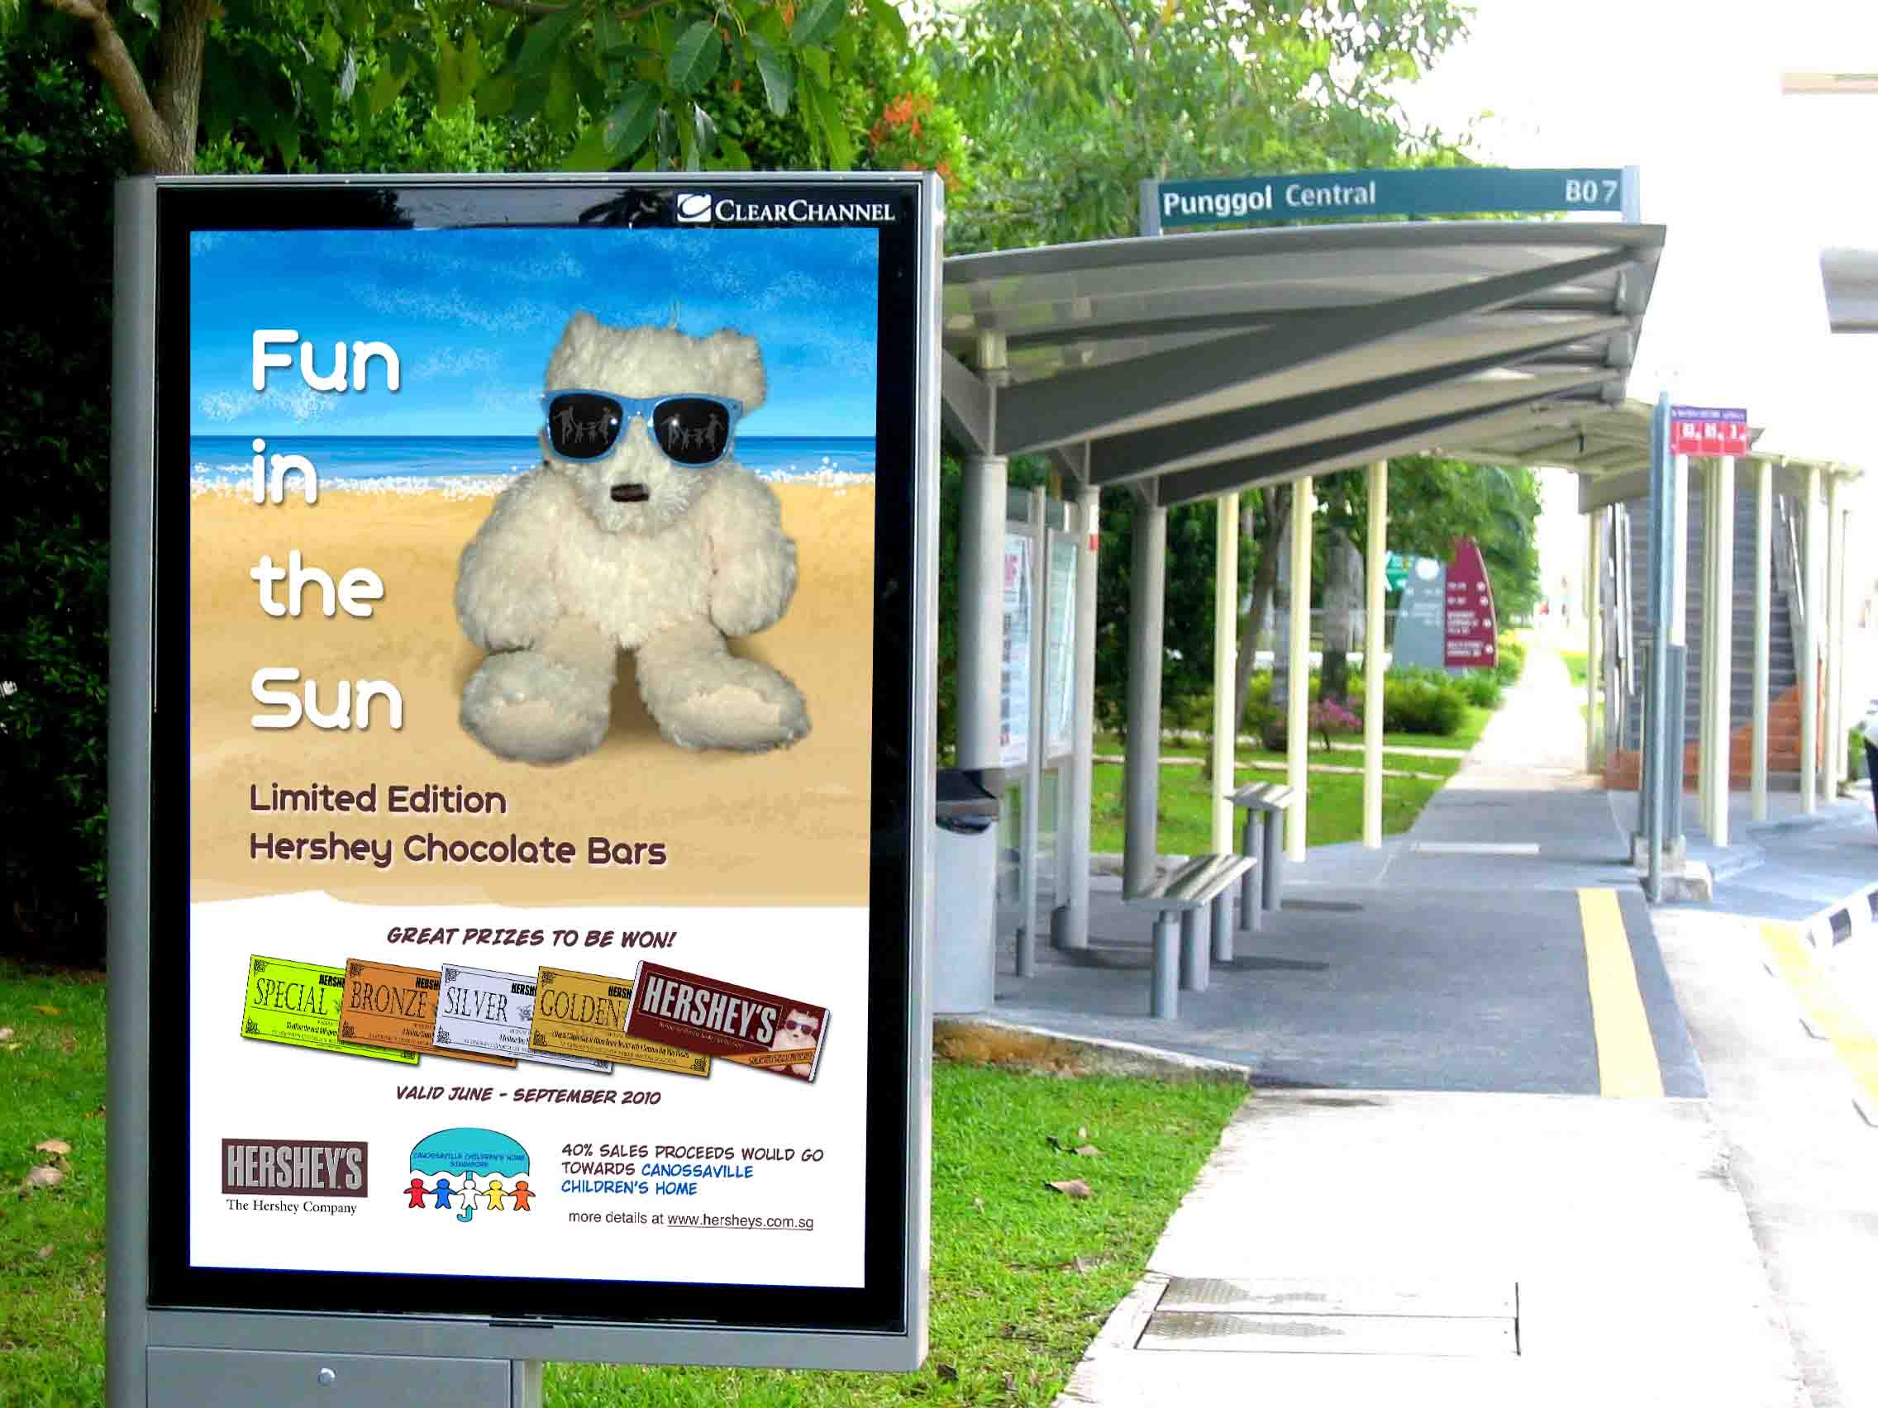
Outdoor Advertising

Slide 21
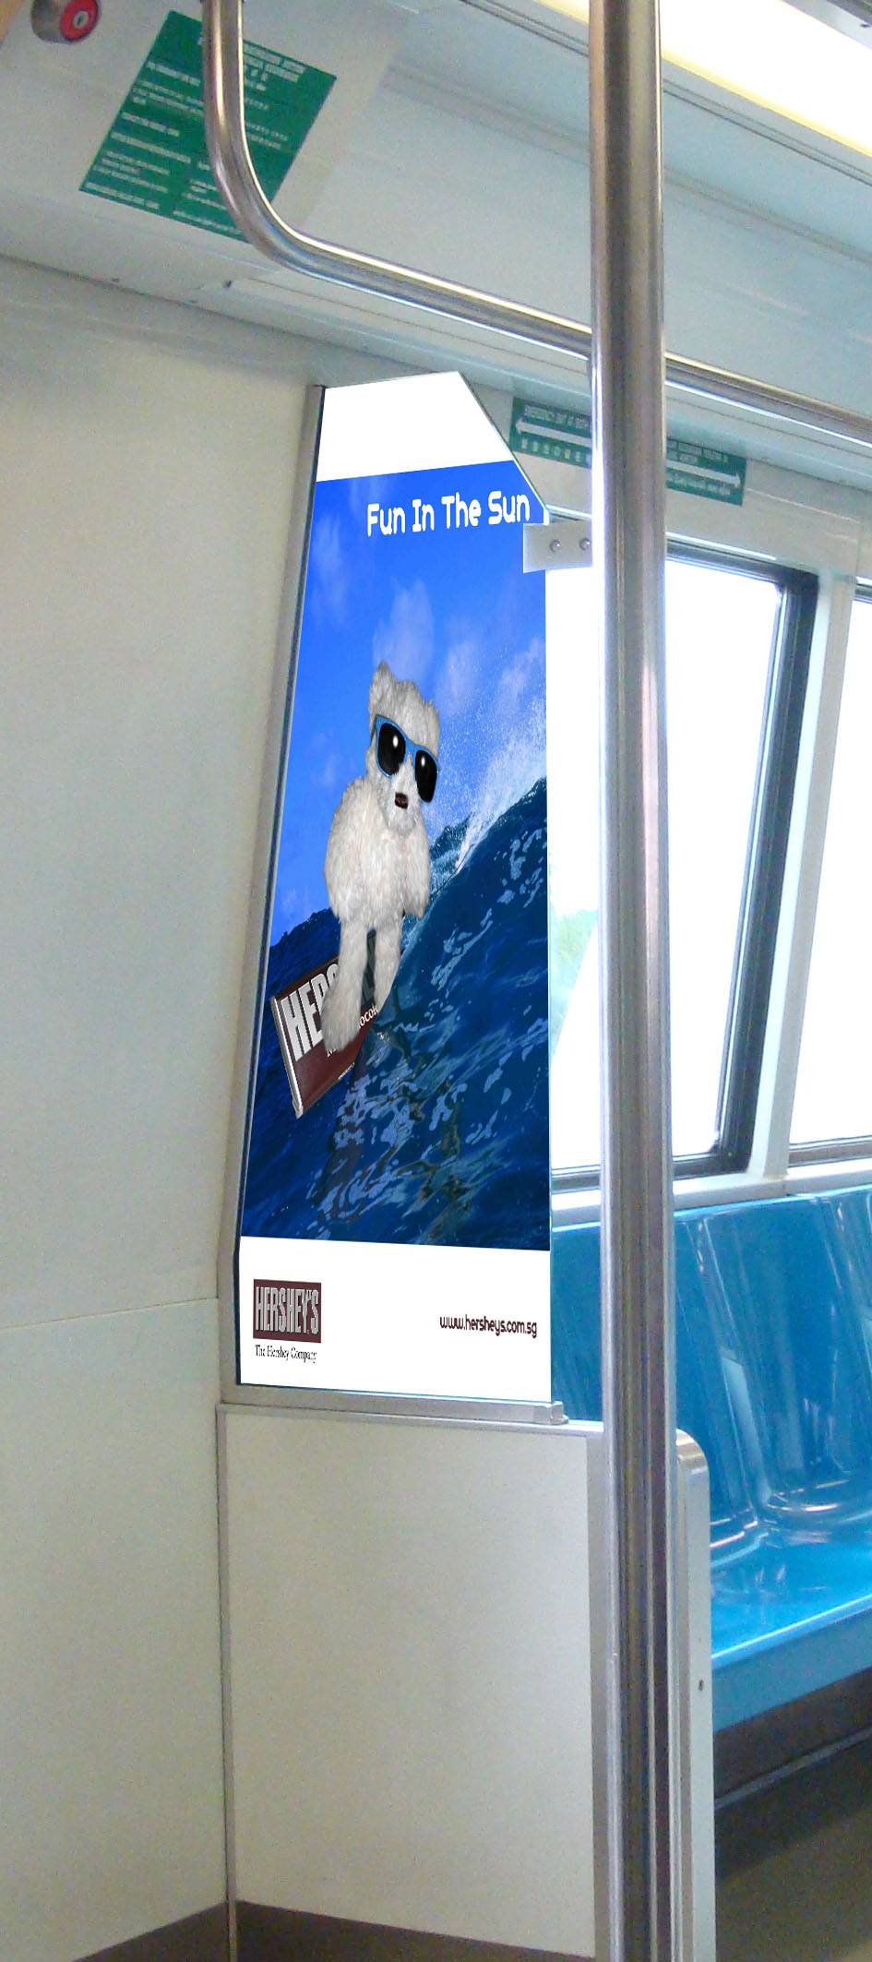

Slide 22
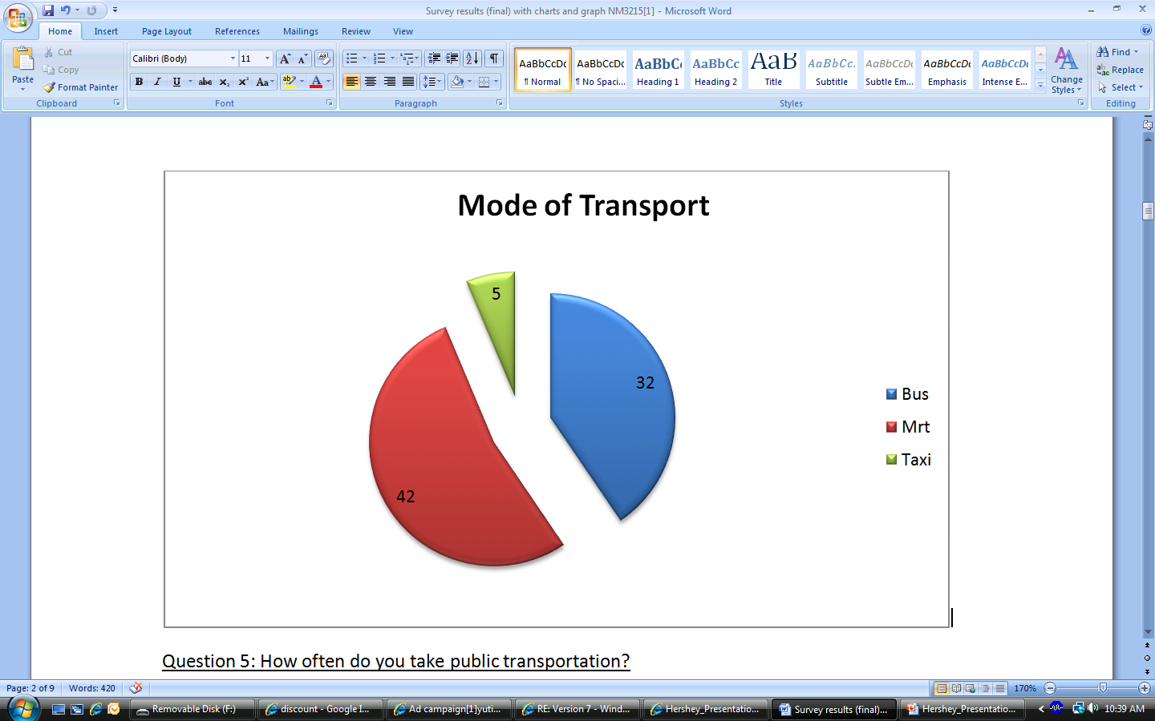

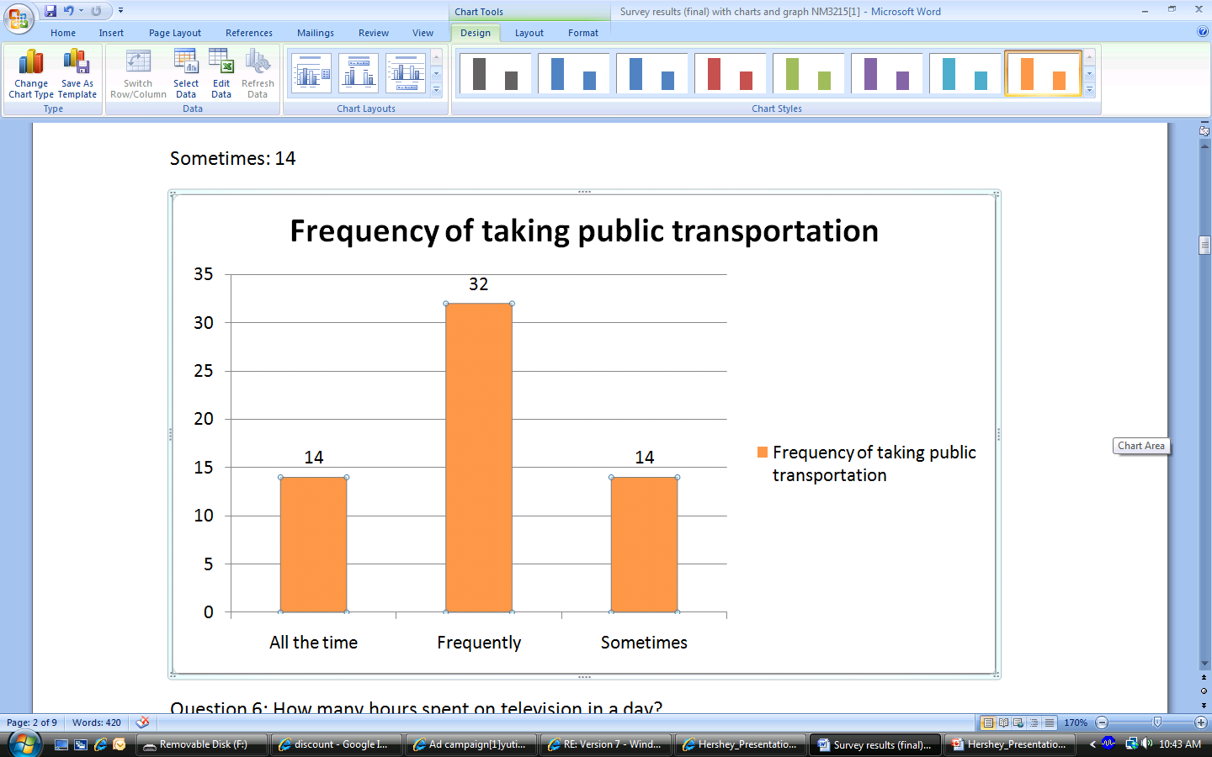
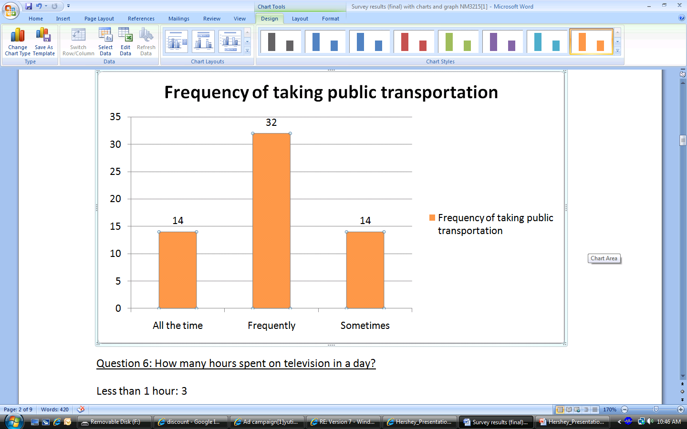
Outdoor Advertising
Mode of Transport
Frequency of taking public transport

Slide 23
Outdoor Advertising
Transit Advertising
Buses and bus stops, especially those near school zones.
MRT stations, inside MRT cabins
Sentosa Express Station, Harbour Front and along the driveway into Resorts World
- Reminder advertising
Estimated Cost: $ 1 690 000

Slide 24
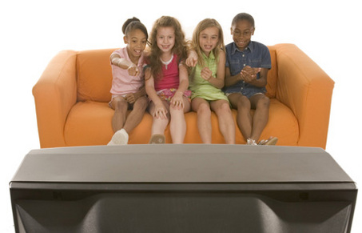
Television
Ad

Slide 25
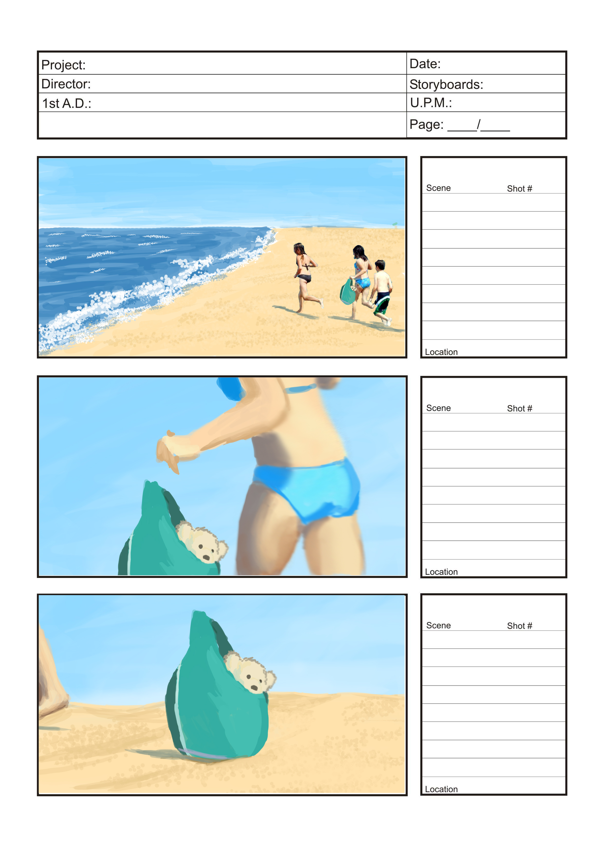
Story Board

Slide 26
Story Board

Slide 27
Story Board

Slide 28
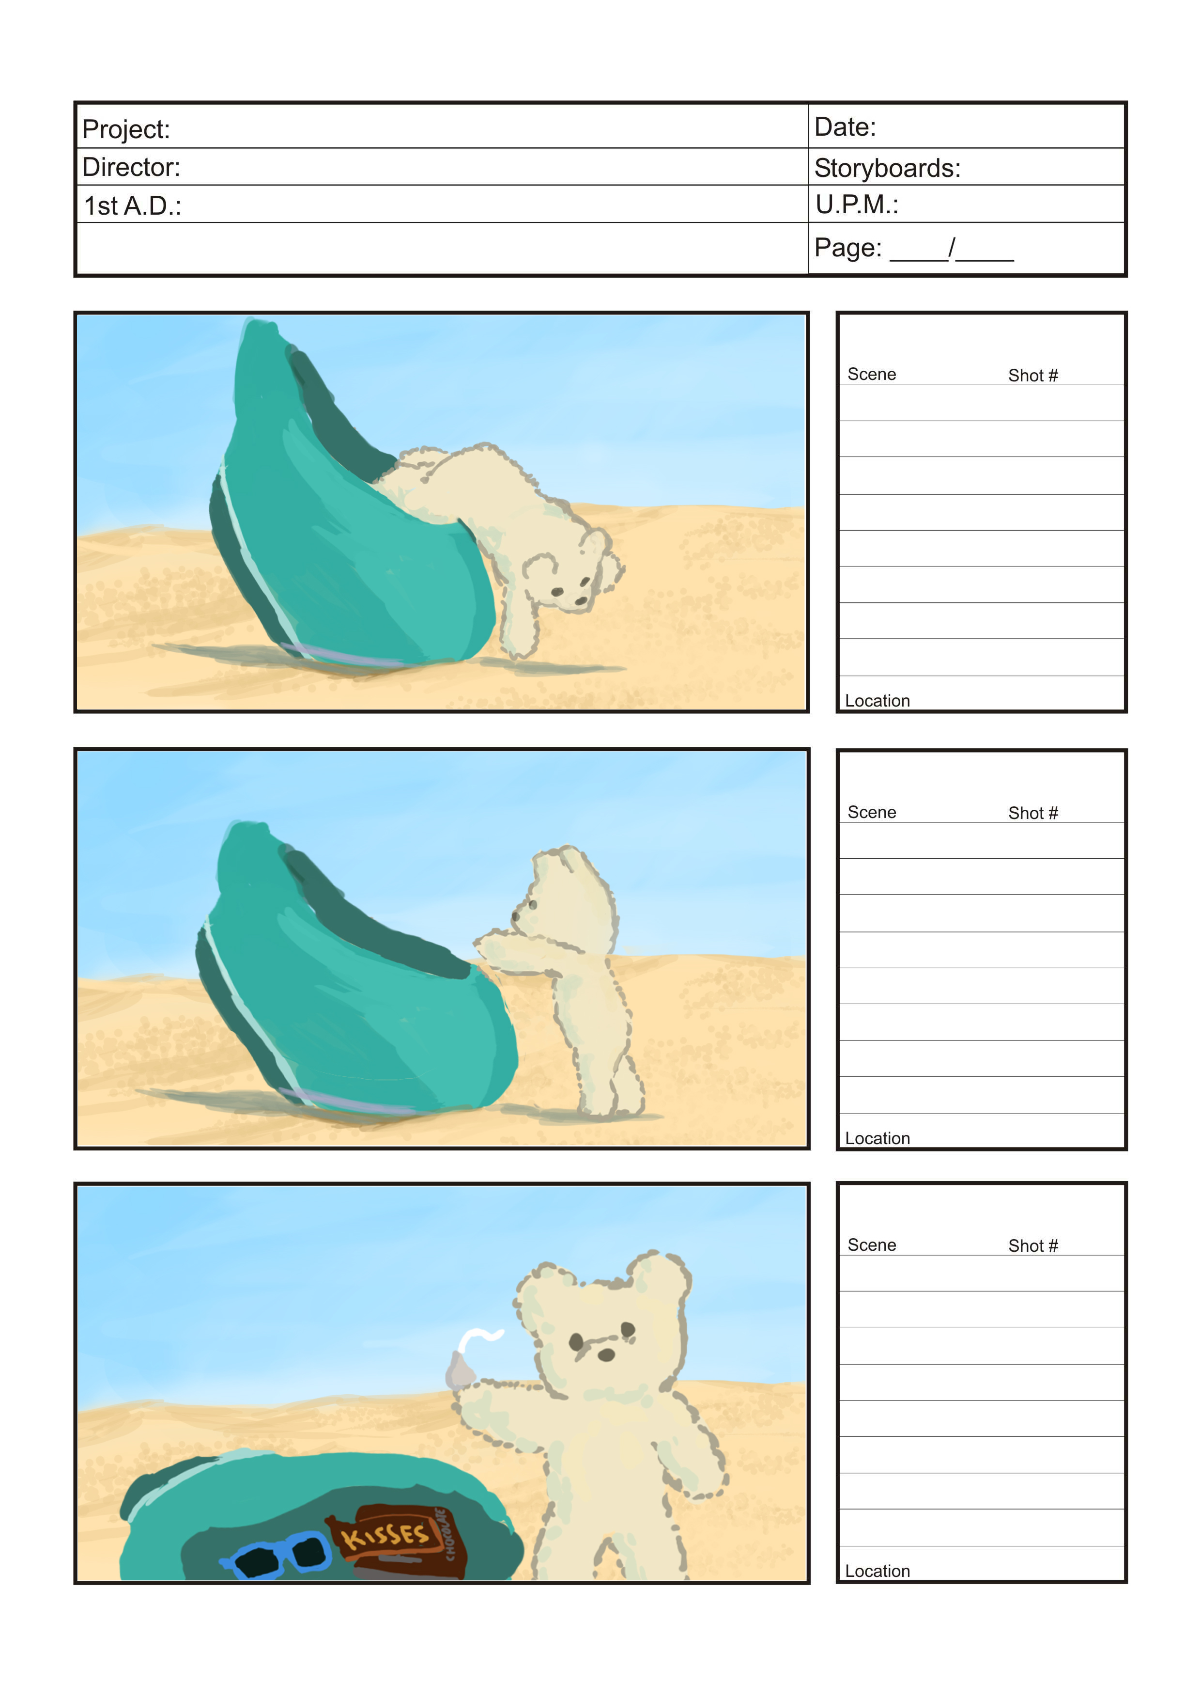
Story Board

Slide 29
Story Board

Slide 30
Story Board

Slide 31
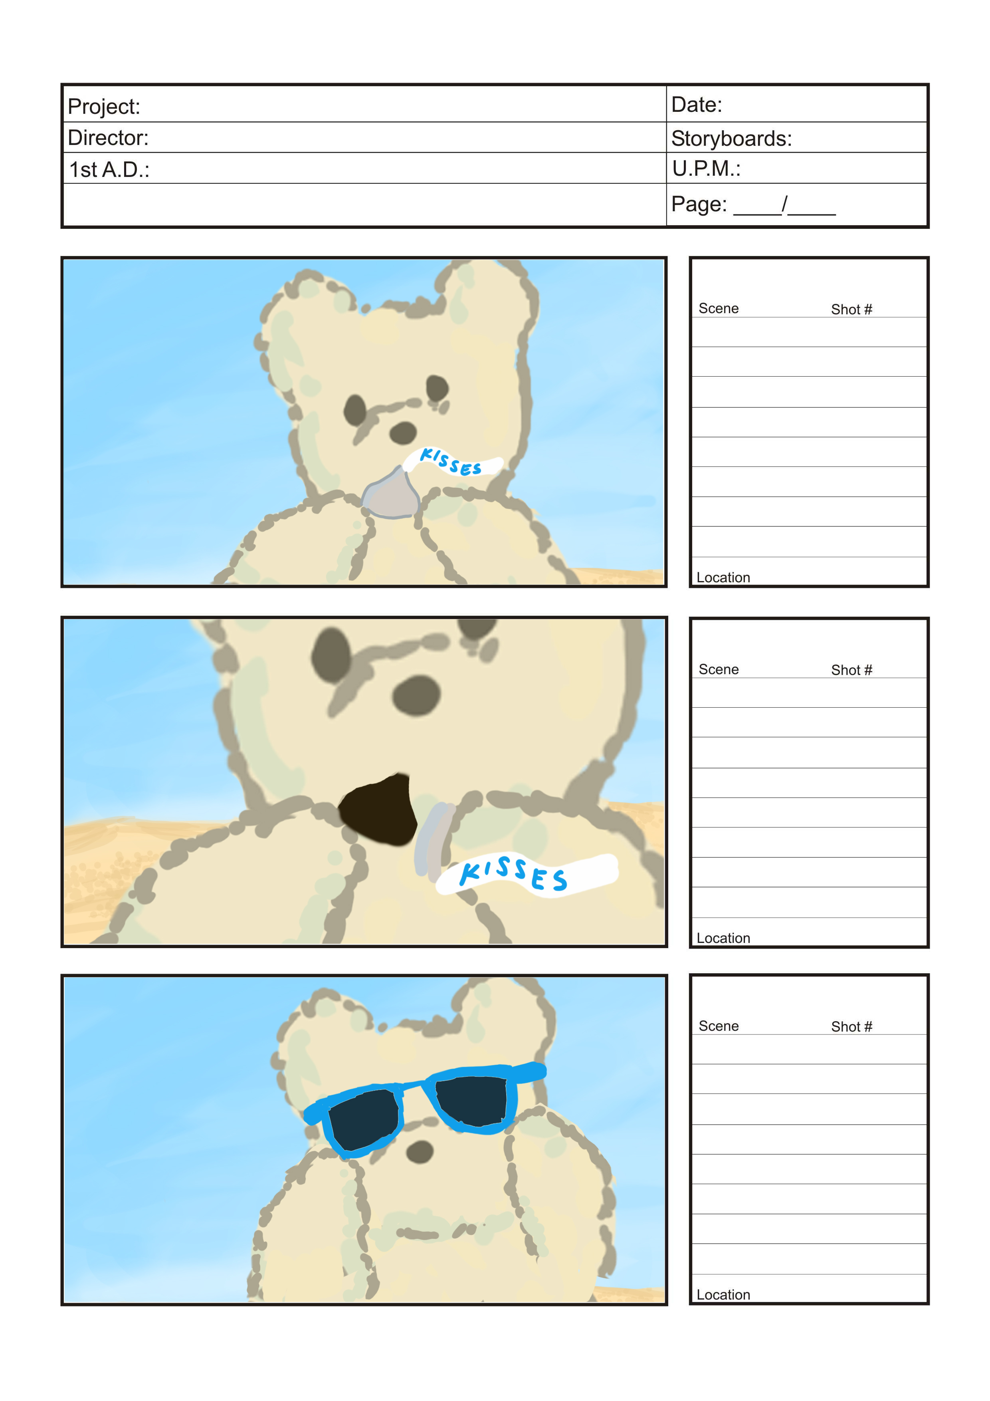
Story Board

Slide 32
Story Board

Slide 33
Story Board

Slide 34
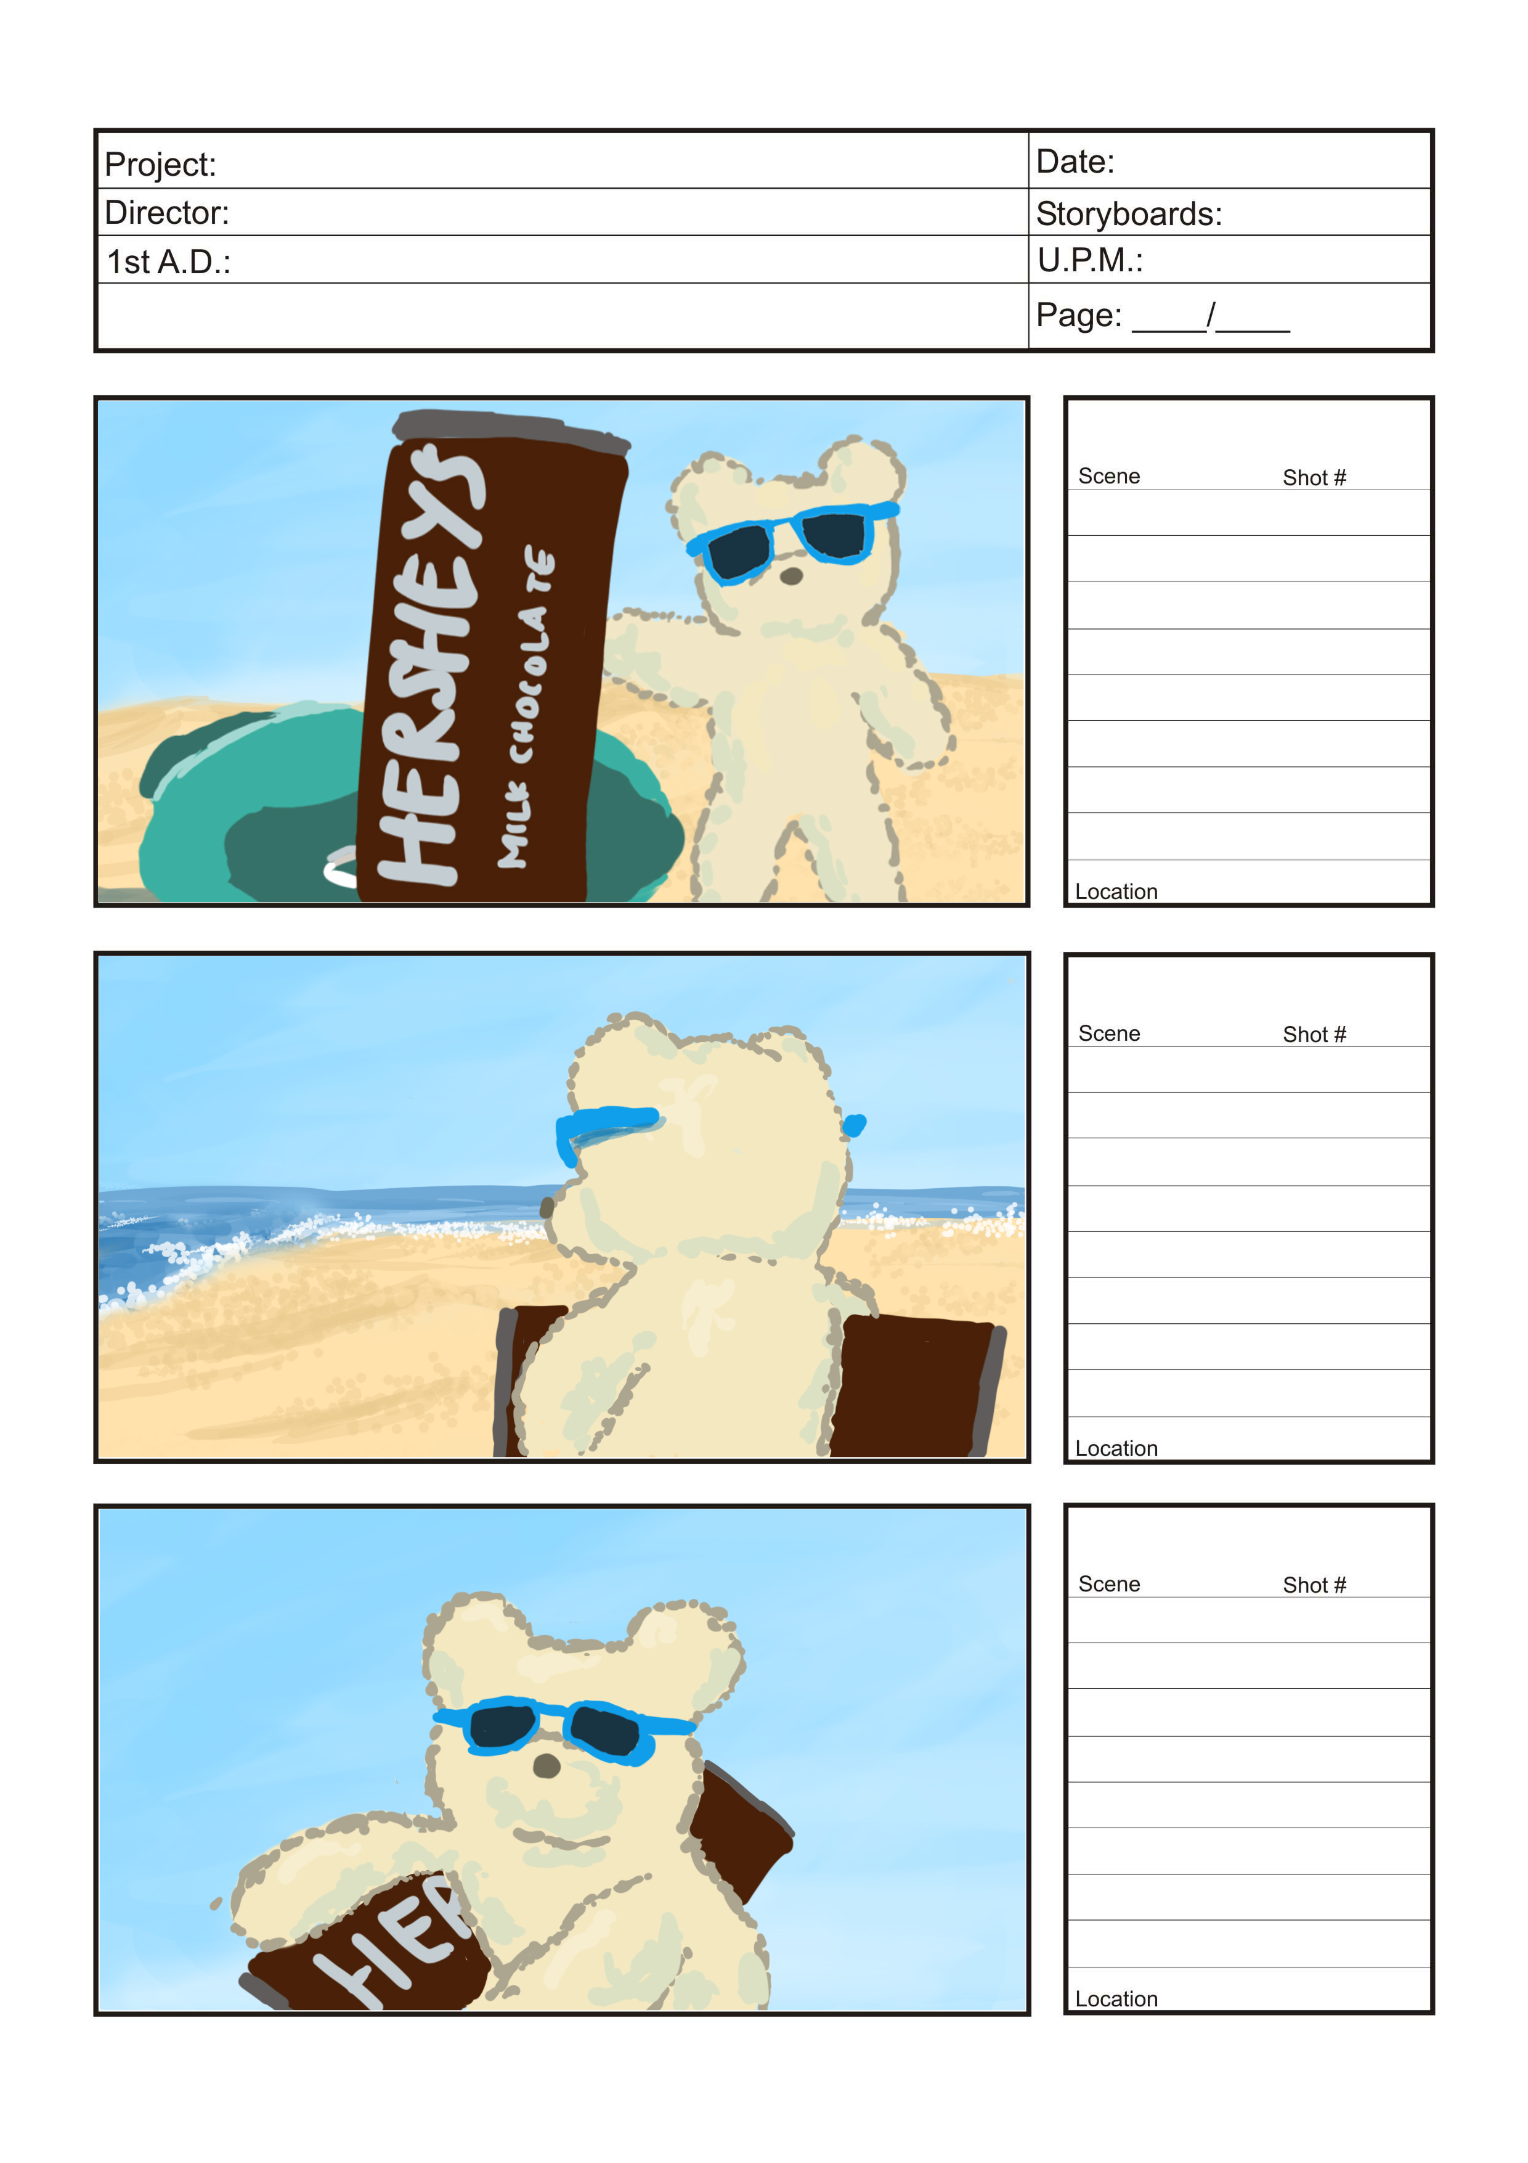
Story Board

Slide 35
Story Board

Slide 36
Story Board

Slide 37
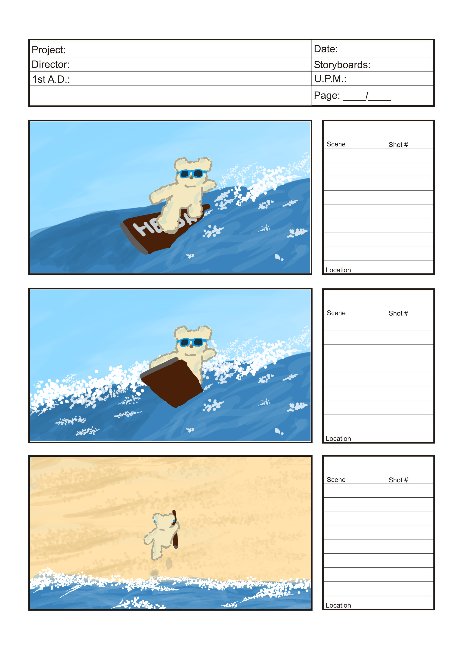
Story Board

Slide 38
Story Board

Slide 39
Story Board

Slide 40
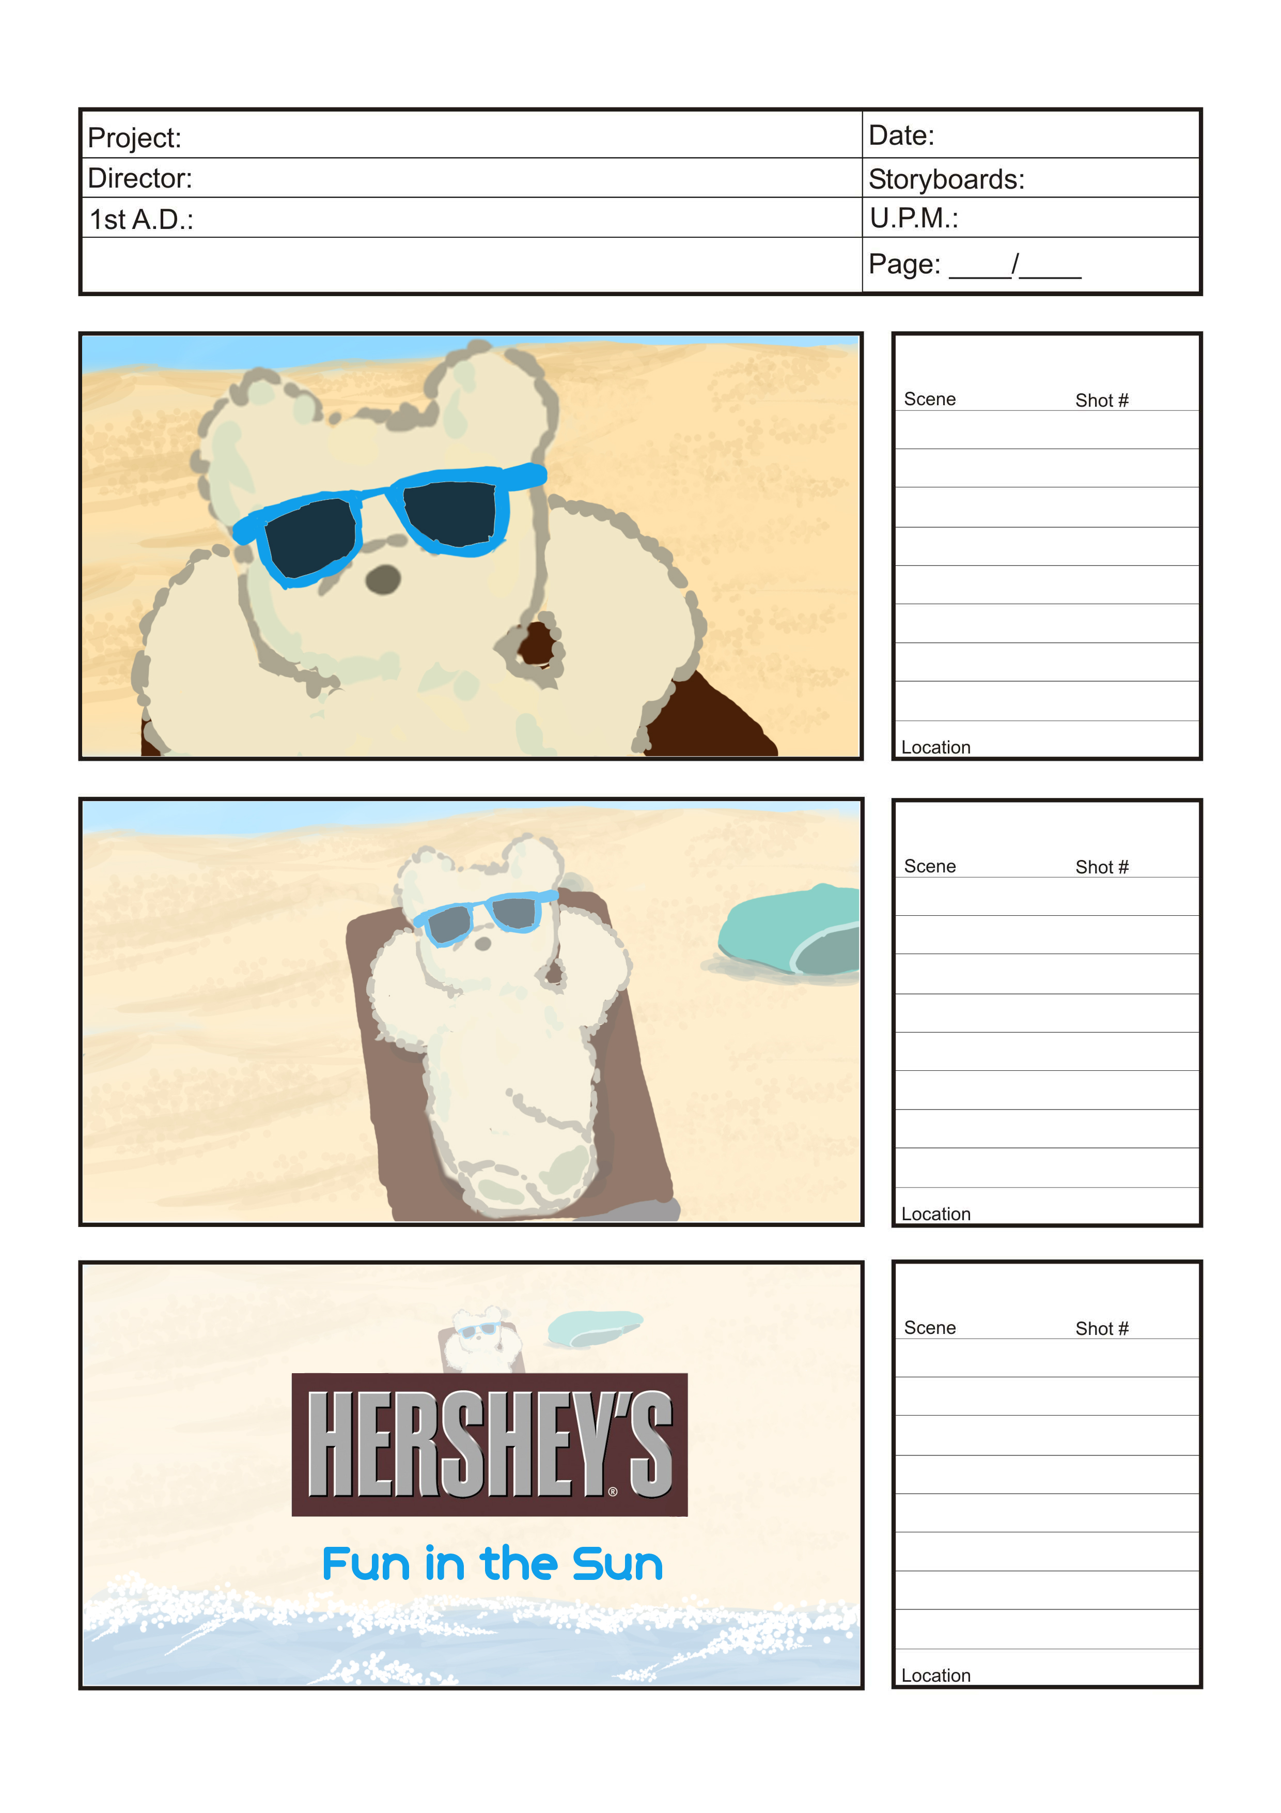
Story Board

Slide 41
Story Board

Slide 42
Story Board
!

Slide 43
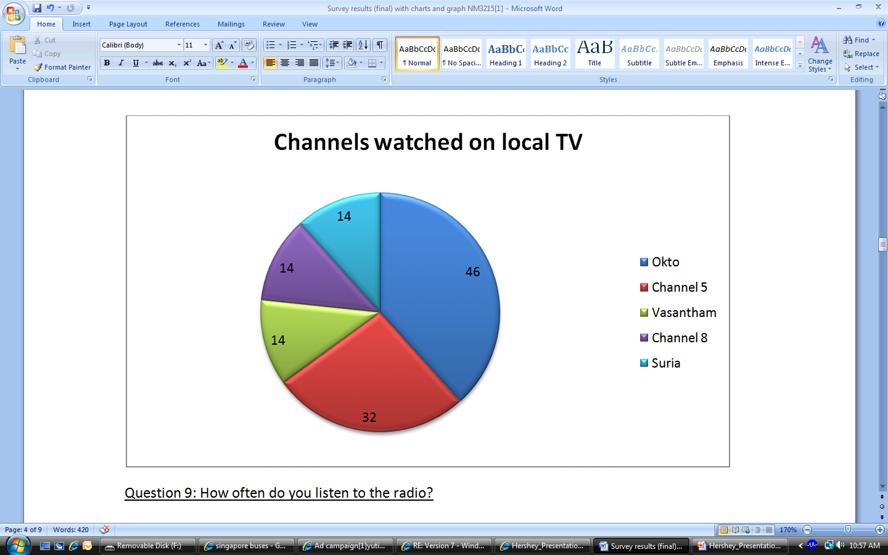
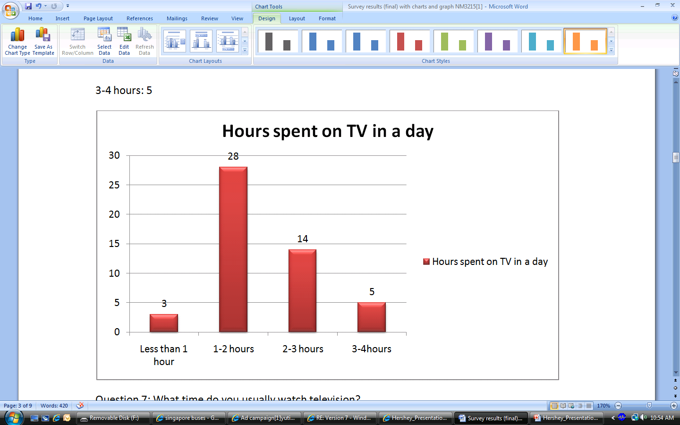
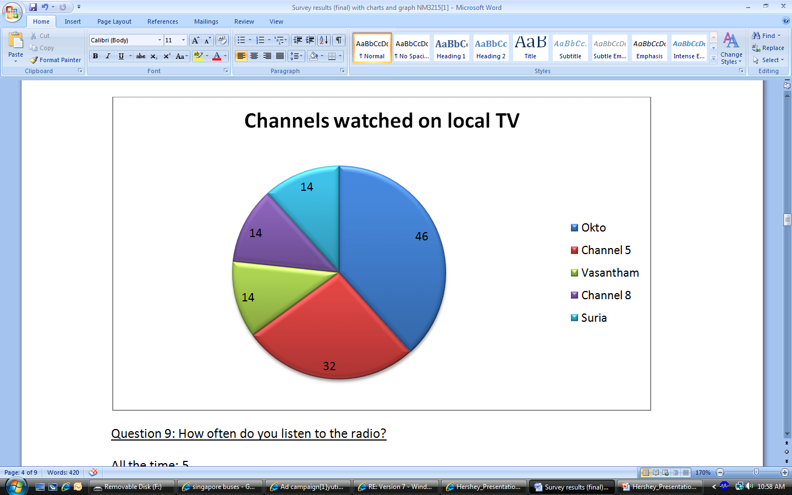

Television Ad
Channels watched on local TV
Hours spent on TV in a day

Slide 44


Television Ad
Still images in the print and outdoor advertisement jump into life.
Okto and Channel 5.
7- 9 p.m. time slot
Estimated Cost: $ 120 000

Slide 45

Magazines

Slide 46
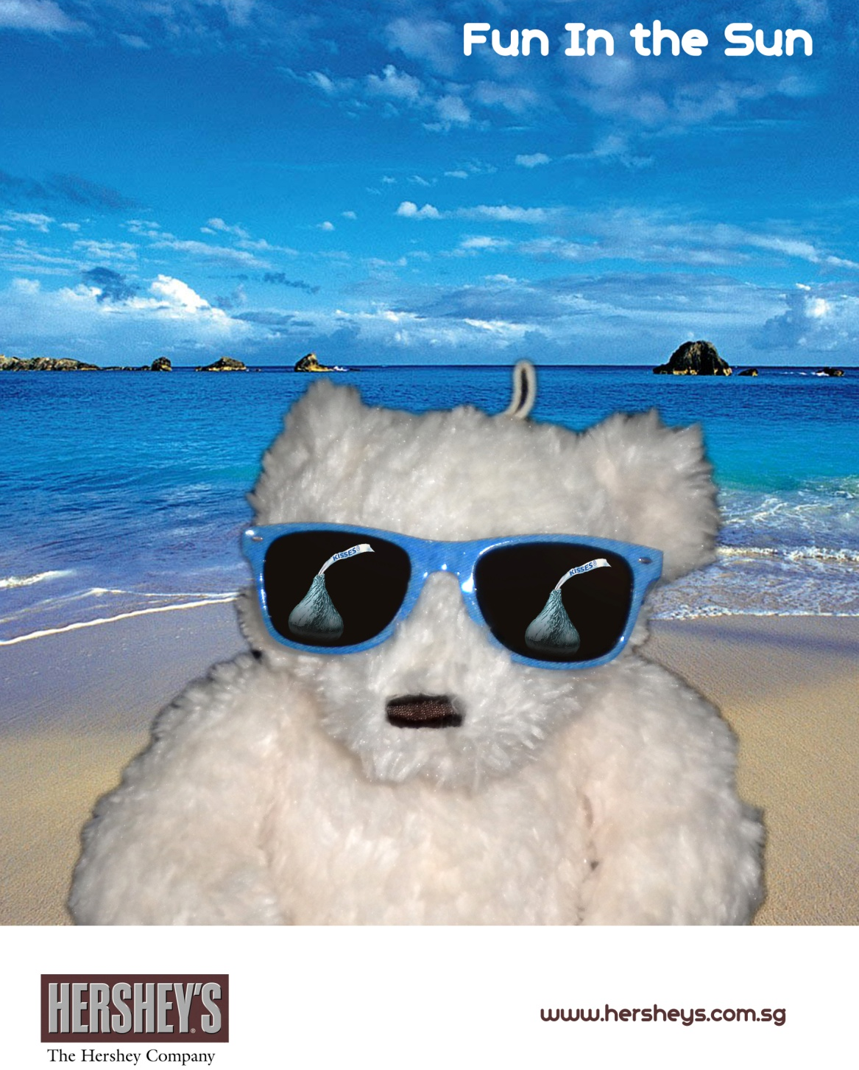
!

Slide 47
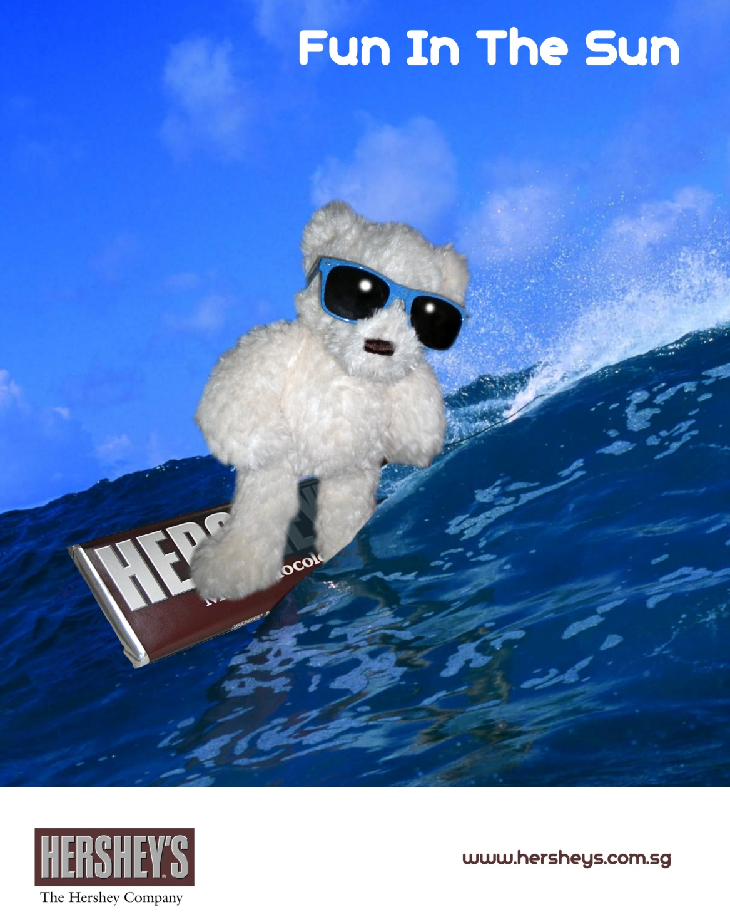
!

Slide 48
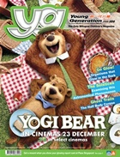

Magazines
Highly segmented audience
High quality print
Posters will appear in full page
Spreads on alternate pages
Estimate Cost: $ 29 600

Slide 49

Online Media

Slide 50

Online Media
Hershey's Chocolate World, Singapore website.
All advertisements will feature the website address, driving consumers to visit the site.
Interactive Avenue
Estimated Cost: $ 5 000

Slide 51
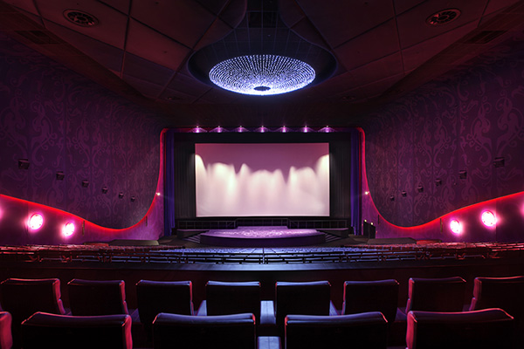
Cinema

Slide 52
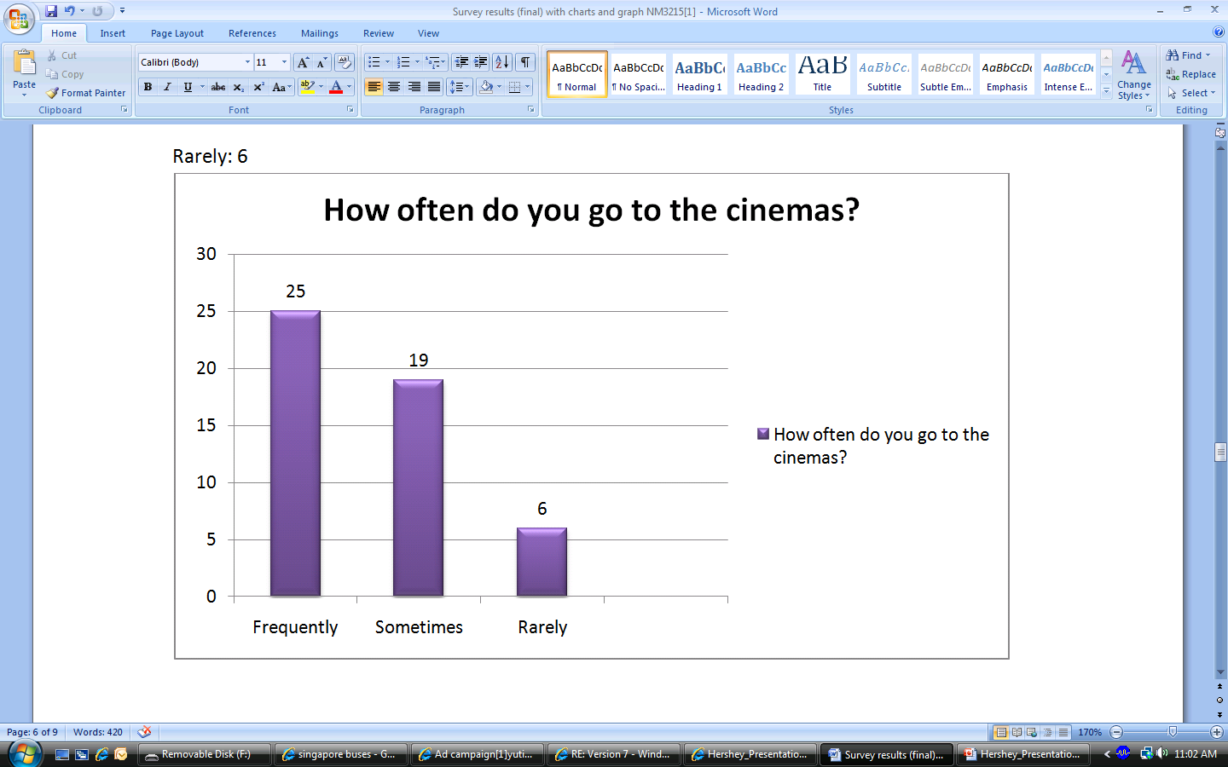
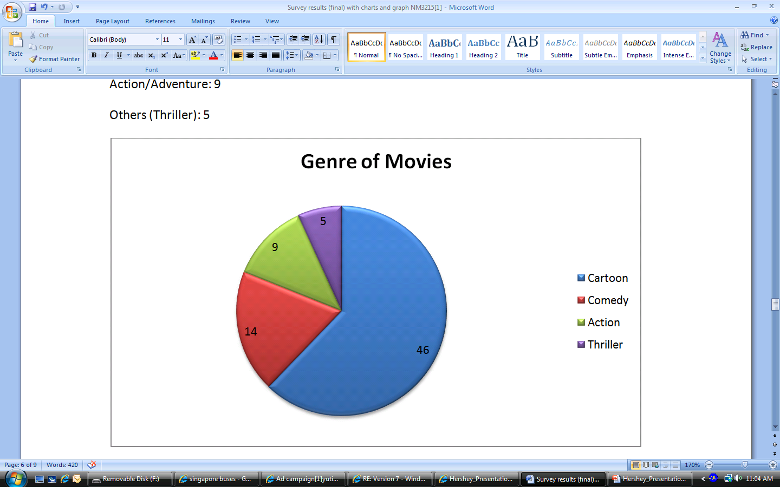


Cinema
Genre of movies watched
How often do you go to the cinema?

Slide 53
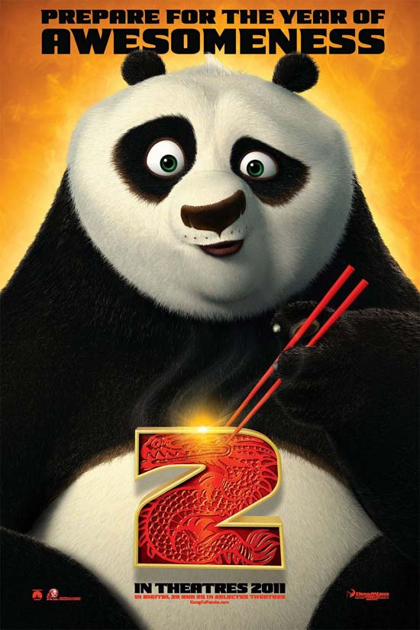
Cinema
Breaks through clutter
Especially Cartoon Movies
Estimated Cost: $ 30 000

Slide 54

Evaluation of Phase 1
Post-campaign polls on a representative sample of target audience

Slide 55
Our Advertising Campaign
Phase 1
Phase 2
Qualitative Objective
Quantitative Objective

Slide 56
Phase II
To increase sales by 20 percent at the Hershey boutique store within 4 months
Qualitative Objective
Quantitative Objective
Create incentives for target audience to drive sales up
Strategy
Sales Promotion
PR campaign
Main Tactics
Supporting Tactics
Supporting Tactics
Online Media

Slide 57
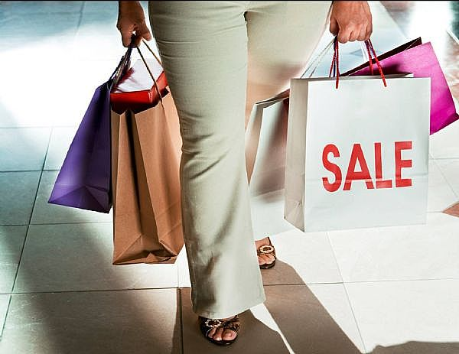
Sales Promotion

Slide 58
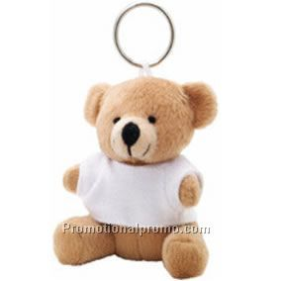
Sales Promotion
With a minimum of $20 spent on a single receipt, premium at $1
Cute miniature limited edition Hershey’s Bear key chain with a tag, “Fun in the Sun!”
1 month period
Estimated Cost: $ 300
“Fun in the Sun !”

Slide 59

Public Relations Event

Slide 60
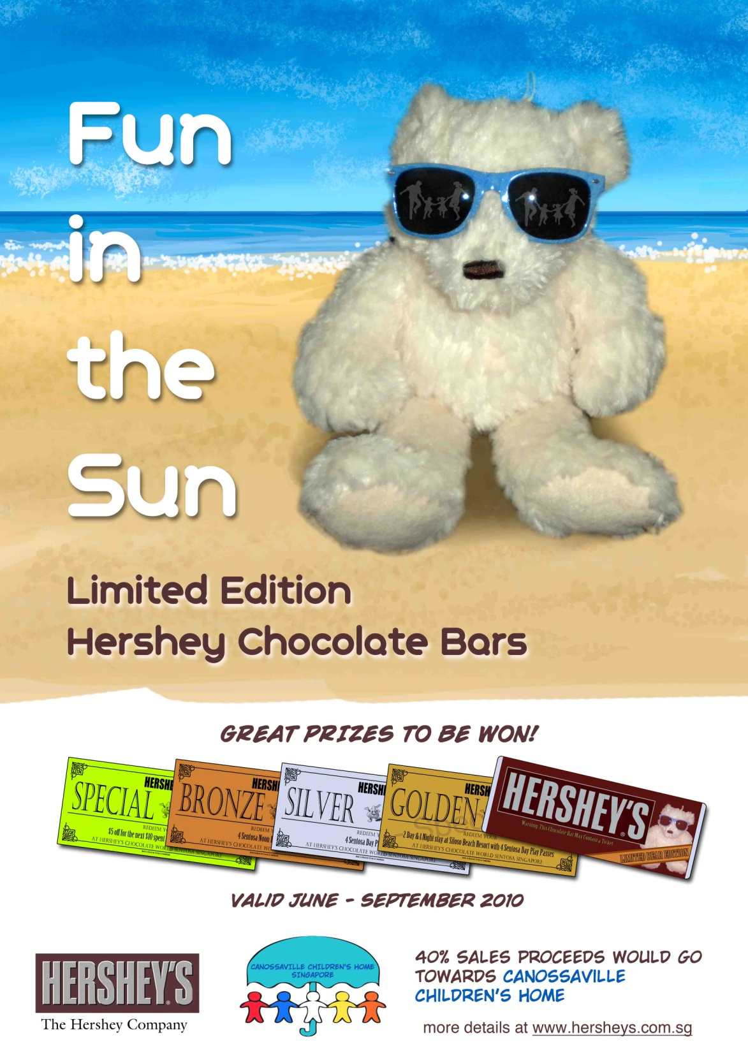

Slide 61
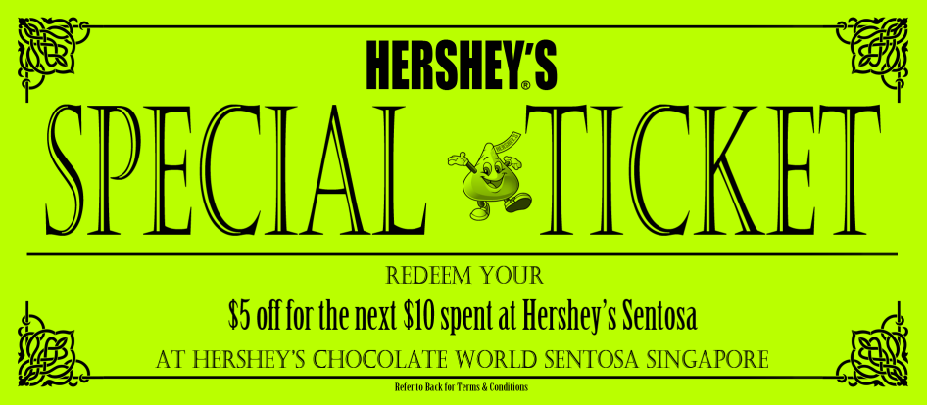
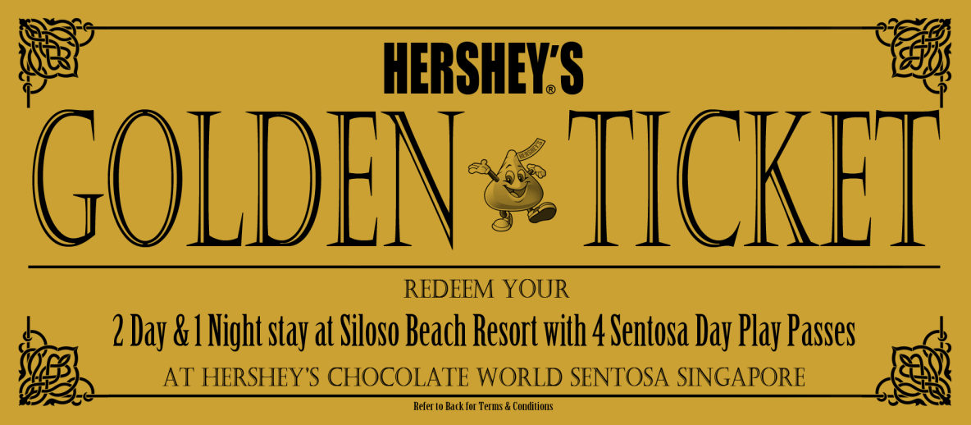
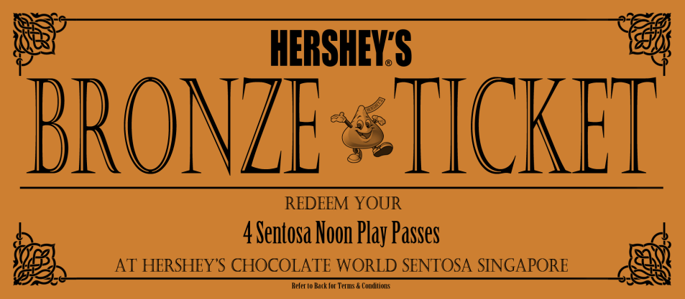
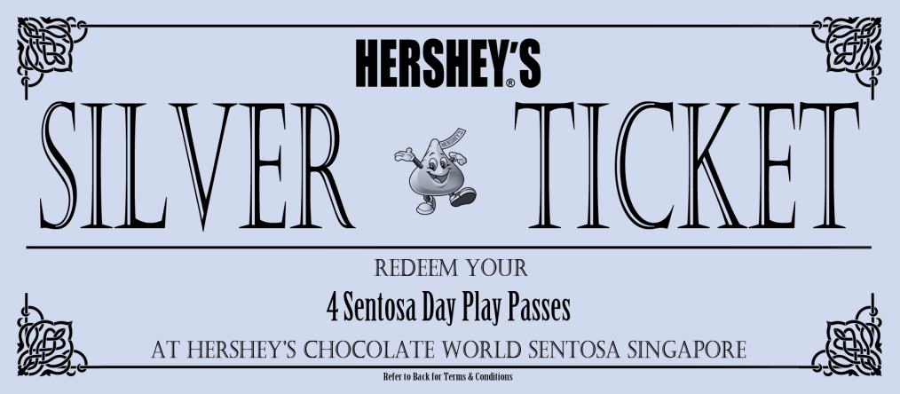
Golden Hershey’s Bear Ticket
3000 special edition Hershey's chocolate bar
3 Gold , 50 Silver, 200 Bronze tickets
Timeline: 3 month
Estimated Cost: $ 49 372

Slide 62

Online Media

Slide 63
Online Media
Interactive game on the website
Children encouraged to play the relatively challenging game to earn points.
100 points = 20% discount at the Sentosa Boutique store
Estimated Cost: $ 1 500

Slide 64

Evaluation of Phase II
Monitor sales rates
Keep track of premiums sold

Slide 65
Recap
Based on our above ad campaign, we aim to:
1. Increase general liking of Hershey’s product among our target audience by 10%
2. Increasing sales by 20%

